Slide 1
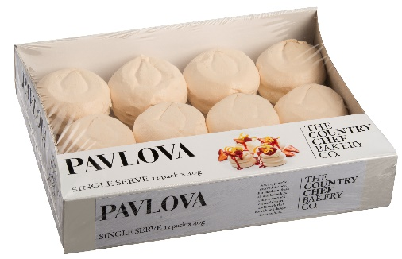
The Country Chef Bakery Co. Instore Storage Guide
All products stored and delivered frozen.
All Products must be date coded at store once thawed, with the date code as per table below.
All products to be stored in a cool, dry place once thawed.
Item Number | Item Description | Ctn Qty | Shelf Life (from thaw)
936300 | The Country Chef Bakery Co. Single Serve Pavlova 12pk | 4 | 14 days
Any questions? – Please feel free to contact on the details below.
Stuart Thrush | Account Manager – Retail
P: 0427 191 261 E: stuart@countrychef.com.au

