Slide 1
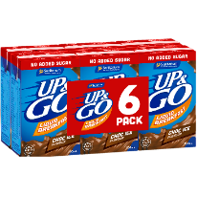
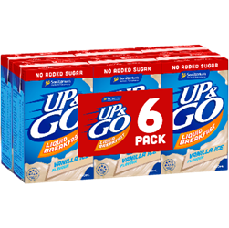
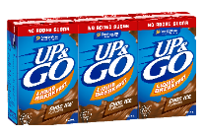
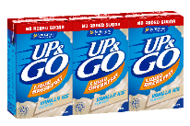
UP&GO
NO ADDED SUGAR
NEW
IN ALL PACK FORMATS AS EACH PLAYS A ROLE IN THE SEGMENT
ENTRY PRICE POINT TO RECRUIT NEW SHOPPERS THROUGH TRIAL
LARGEST PROMO BUNDLE IN UP&GO
ITEM CODES | DESCRIPTION | UPC | Price / RRP | APN
182422 | UP&GO CHOC ICE NAS 3x250ML | 8 | Line Price 3pks | 9300652809596
359638 | UP&GO VAN ICE NAS 3x250ML | 8 | Line Price 3pks | 9300652809626
182414 | UP&GO CHOC ICE NAS 6x250ML | 4 | Line Price 6pks | 9300652809602
182406 | UP&GO VAN ICE NAS 6x250ML | 4 | Line Price 6pks | 9300652809633
PRICE & PROMOTIONS ALIGNED WITH CORE RANGE
AVAILABLE IN CHOC ICE & VANILLA ICE 3PKs, 6PKs
AVAILABLE TO ORDER JANUARY 2020

