Slide 1
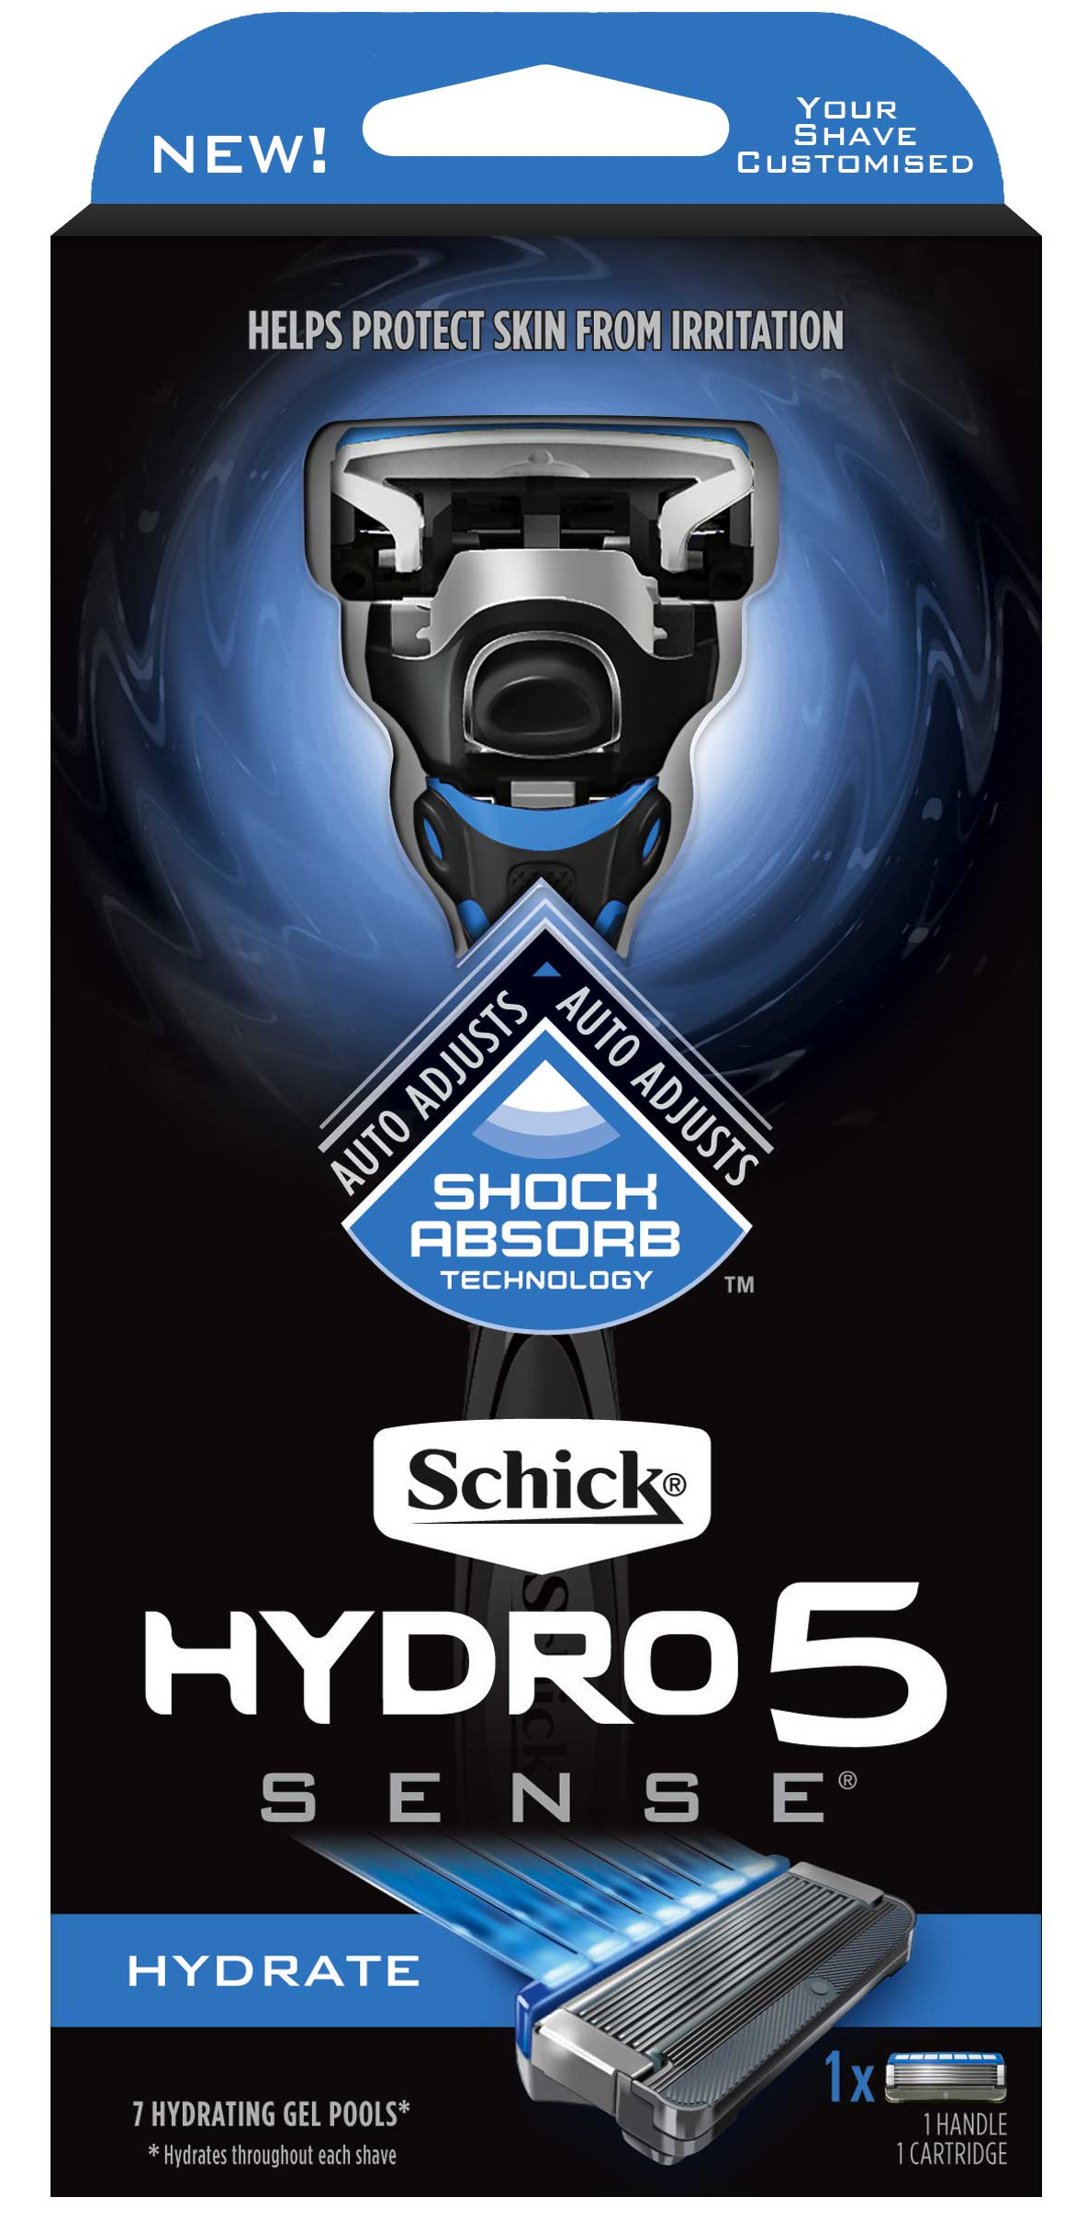
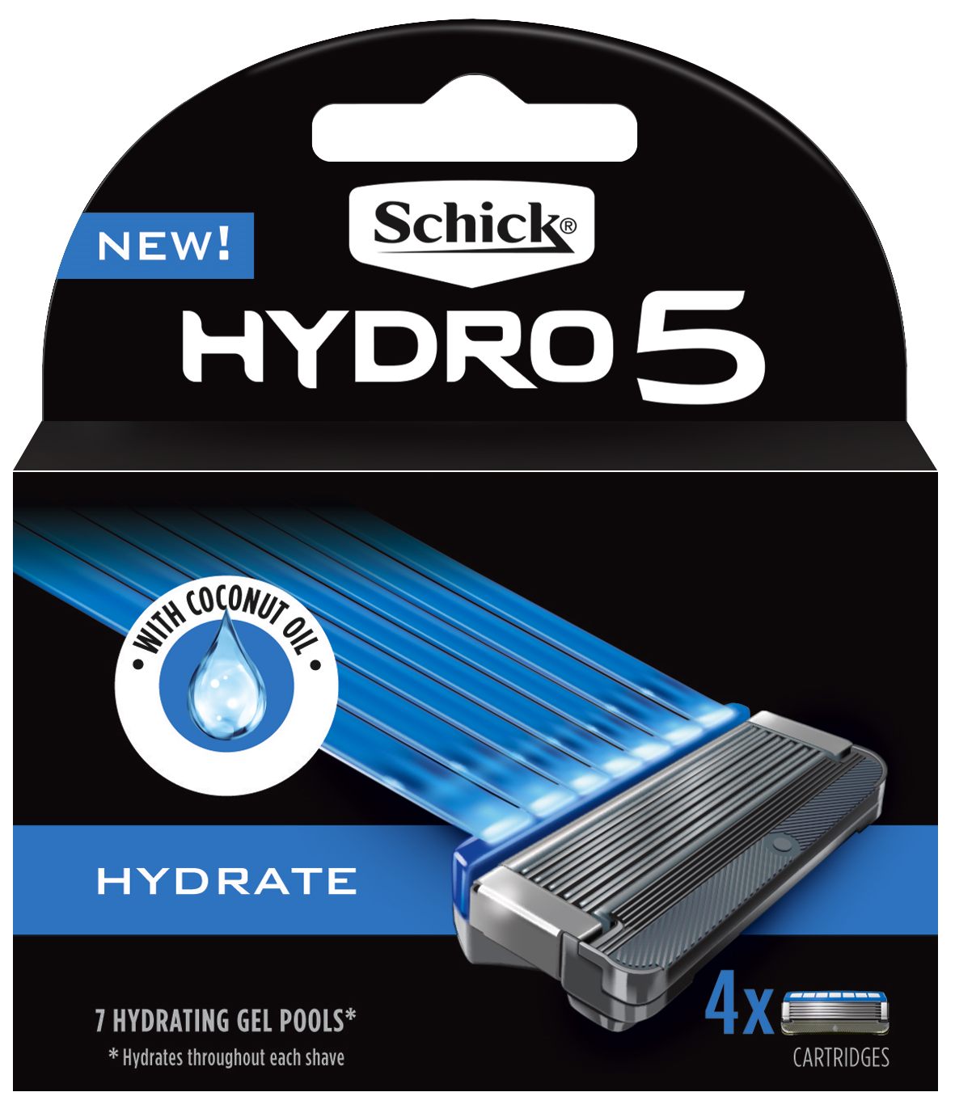
Schick Hydro Sense Kit, Refill and Shave Prep
Order 1 inner of each and receive a great New Line Offer
NEW!
HYDRATE
with Coconut Oil
Hydrates skin after shaving*
Key benefits
Unique Shock Absorbing Technology
Your shave customised for how you shave
Protects skin from irritation
Comfort – with Herbal Extracts to comfort your skin as you shave
RETAIL | $6.99
Deal | $6.00
Inner QTY | 6
TIR No | 197130
Appeals to men who most value the feeling of Hydrated Skin
Added Coconut Oil to keep skin hydrated after shaving:
RETAIL | $16.00
Deal | $12.00
Inner QTY | 6
TIR No | 231909
RETAIL | $26.99
Deal | $20.00
Inner QTY | 10
TIR No | 231984
Formulated with vitamin E and advanced moisturisers and conditioners to give you a close, smooth shave, and a cool refreshing finish
Benefits: Helps protect skin from irritation Added Vitamin E to soothes and nourish skin Extra lubricants optimise razor glide Conditioners give your face a refreshing coolness
I like the idea of
coconut oil
My face tends to dry out after shaving. Anything to help with moisturisation is great
The idea that my skin will continue to be hydrated after use sounds appealing

