Slide 1
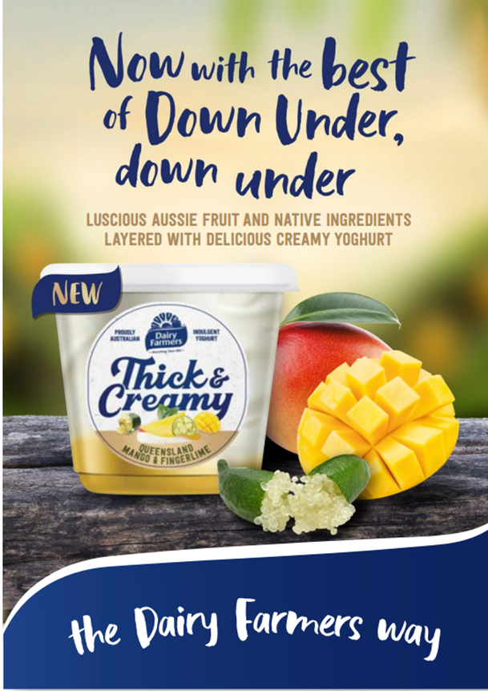
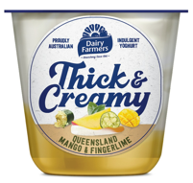
Dear Retailer
Bega Dairy & Drinks is excited to launch its latest edition to the Dairy Farmers Thick & Creamy range - Dairy Farmers Australian Fruits and Natives layered range.
To help support with this launch Bega are offering a FREE carton of each sku to be allocated to stores from wc 11th September.
Product Information:
A delicious range of layered yoghurts made with creamy Dairy Farmers yoghurt and locally sourced Australian fruits and natives to give you a luxurious yoghurt perfect for a little reward.
Available across both 550g & 140g pack sizes in the below flavours (6 skus in total):
Queensland Mango and Finger Lime
Sunshine Coast Strawberry & Wattleseed
Pineapple & Bundaberg Passionfruit
PRODUCT LAUNCH & ALLOCATION
IGA Tasmanian Marketing Plan:
These products will be supported initially through catalogue advertising (wc 4th October) and opening specials across both pack sizes.
Post launch this product range will fall into the same promotional frequent as existing 150g and 600g Dairy Farmers Thick & Creamy range.
140g range
550g range
Product Codes:
Product Code | Product Desc | Retail Size | RQPU
671349 | (T)D/FARM THK&CRM QLD MANGO | 140GM | 10
671357 | (T)D/FARM THK&CRM QLD SBERRY | 140GM | 10
671496 | (T)D/FARM THK&CRM QLD PINE/PFR | 140GM | 10
671509 | (T)D/FARM THK&CRM QLD MANGO | 550GM | 6
671525 | (T)D/FARM THK&CRM QLD SBERRY | 550GM | 6
671584 | (T)D/FARM THK&CRM QLD PINE/PFR | 550GM | 6
Bega In Field Support:
Please contact your local Bega representative or Marcus Evans (Ph. 0419 155 643) if you have any questions. Each team member has plenty of POS and product trays to help with this launch.

