Slide 1
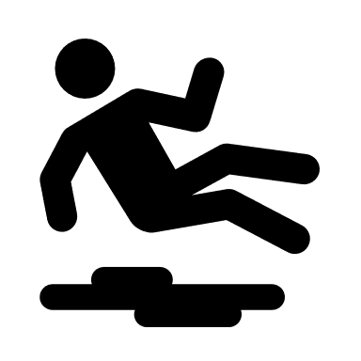
Preventing slips, Trips and Falls
Colleagues and customer accidents resulting from slip, trips or falls account for our greatest number of accidents and can result in serious injuries particularly when involving vulnerable customers.
Aim
Our aim is to keep all TIR Networks places of work free from things that could cause people to slip, trip and fall.
Our Standard
Premises should be designed and maintained to minimise slip or trip hazards, this would include for example, providing barrier matting at entrances and slip resistant flooring behind counters.
A clean as you go process must be in place to ensure all colleagues keep their working area free from hazards.
All colleagues must be aware of how to safely manage spillages in their work environment.
Colleagues must immediately report floor, stair and equipment defects that increase the risks of falls.
Appropriate footwear must always be worn by colleagues.
All workplaces must be inspected regularly to identify potential slip, trip and fall hazards and where possible remove them.
Typical hazards include: water or other substances, loose produce or spilt merchandise on a hard floor, trailing cables, damaged flooring, or waste/equipment or merchandise left in walkways.

