Slide 1
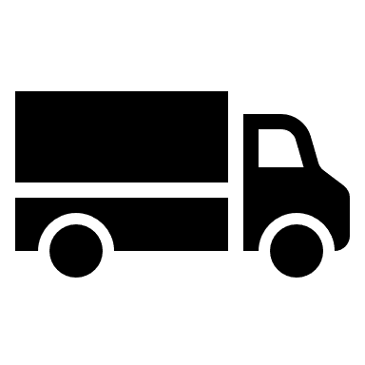
Goods Vehicle Management
If not properly managed, the distribution of goods across our businesses presents significant risks to those operating a vehicle, member of the public or our customers.
Aim
We will always ensure that the use of goods vehicles is carried out by ourself or third parties in a planned and safe manner to prevent the risk of harm.
Our Standard
All good vehicles and associated equipment selected must be suitable for the task required.
All vehicles and work equipment must be checked prior to use to ensure they are in good working order and suitable for the task intended.
All vehicles and work equipment must be regularly inspected by a competent organisation and/or person, to identify any faults or defects.
All good vehicles must be maintained in accordance with manufacturers/ suppliers' recommendations and Heavy Vehicle National Regulations.
All drivers of goods vehicles must hold the relevant licences for the type of vehicle they drive. Licenses must be checked at least annually.
All drivers of goods vehicles must know how to load it safely, within mass and dimension limits and be trained and equipped to securely restrain loads.
Where recorded, drivers' hours must be reviewed at the end of each working shift to ensure compliance with National Heavy Vehicle driver fatigue laws.
Our Distribution Centre must be designed to allow for the safe movement of goods, materials and people to prevent vehicle related incidents.
Members of the public and nonessential employees must not be permitted into areas where vehicles are moving or being loaded/unloaded.
Where vehicles operate, adequate speed controls and clear warning signs must be in place.
All employees at risk from vehicular operations must be provided with safety footwear and high-visibility clothing.

